Slide 1
Student Wellness & The Assembler
Stress and Student Wellness, Inside the Assembler, Compilers and The Software Stack, Hack CPU Logic Example

Slide 2
Lecture Outline
Stress and Student Wellness
  Investing Time for Self-care and Well-being
Inside the Assembler
  Assembler Motivations and Challenges
  Parsing, Symbols, Encoding
Compilers and The Software Stack
  Steps for Compiling Software
Hack CPU Logic Example: writeM
  Project 6 CPU Logic Exercise

Slide 3
Stress and Student Wellness
Students are generally reporting increasing depression, anxiety, and suicidal thoughts
  The stress we feel from school can amplify these feelings
A lack of self-care can hinder our academic performance as a student
In a survey, over 80% of students felt that emotional or mental difficulties have hurt their academic performance (UW Healthy Minds Survey, 2017)

Slide 4

Stigma and Seeking Help
Asking for help can be challenging and take humility
However, seeking is an important step for self-care and helping us perform better academically
94% of UW students disagreed with the statement, “I would think less of someone who has received mental health treatment.” (UW Healthy Minds Survey, 2017)

Slide 5

Student Wellness Discussion
In groups, discuss the following questions:
What is your typical response for when life circumstances becomes stressful?
What are some strategies you can utilize for managing stress?
What actionable steps can you take to foster your own well-being? What are some SMART goals you can set?

Slide 6
Strategies for Managing Stress
Set aside time for leisure time to do something you enjoy (e.g., reading, knitting, gaming, completing a puzzle, etc.)
Take care of your body by eating healthily, exercising regularly, getting enough sleep, etc.
Write down all the things in your mind that is causing the stress you are experiencing
Take the time to connect with people 1:1 or with a community and share about your life

Slide 7
Being There for One Another
Promote a climate of care and inclusion among your peers in the UW and Allen School
Look for warning signs (unusual moods, relationship dynamics, academic patterns, suicidal thoughts)
Express concern for your peers and let them know that you are there for them
Point them to resources for seeking additional help

Slide 8
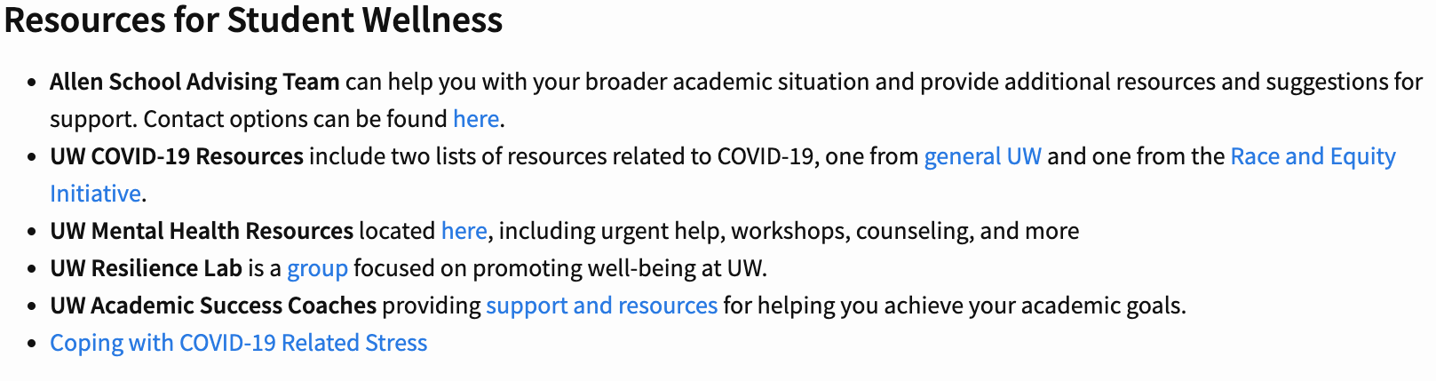
Resources for Seeking Additional Help
If depression, anxiety, or thoughts about suicide become a pattern, be proactive about reaching out for help
Several resources available from both UW and within the Allen School
  UW resources include SAFECAMPUS, UW Counseling Center, etc.
  See the CSE 390B Resources page for more
https://courses.cs.washington.edu/courses/cse390b/22au/resources.html

Slide 9
Lecture Outline
Stress and Student Wellness
  Investing Time for Self-care and Well-being
Inside the Assembler
  Assembler Motivations and Challenges
  Parsing, Symbols, Encoding
Compilers and The Software Stack
  Steps for Compiling Software
Hack CPU Logic Example: writeM
  Project 6 CPU Logic Exercise

Slide 10

Producing Machine Code
while (i < 100) {
sum += arr[i];
i++;
}
Java
Compile
MEM
CPU
0101110011100110
1011000101010100
1110001011111100
...
Machine Code Instructions
PROGRAM
DATA
Load & Execute
REGISTERS
CONTROL
movq $5, %rdx
addq %rsx, %rdx
movq %rdx, %rax
ret
Assembly Language
Assemble

Slide 11
The Assembler’s Job
Value:
A 15-bit unsigned value to load into A register
0 v v v v v v v v v v v v v v v
1 1 1 a c c c c c c d d d j j j
Family:
0 = A-Instruction
1 = C-Instruction
Unused
Comp:
ALU Operation (a bit chooses between A and M)
Dest:
Where to store result
Jump:
Condition for jumping
D=D+1
1 1 1 0 1 1 1 1 1 0 1 0 0 0 0
Assemble
D+1
D
null

Slide 12
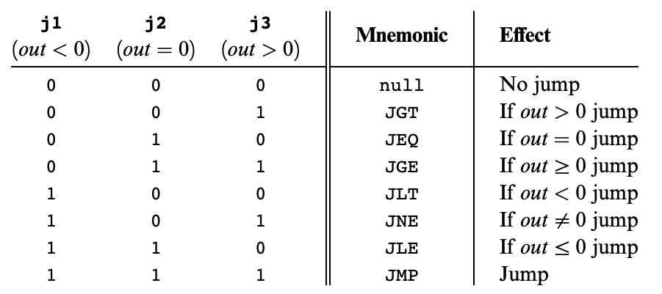
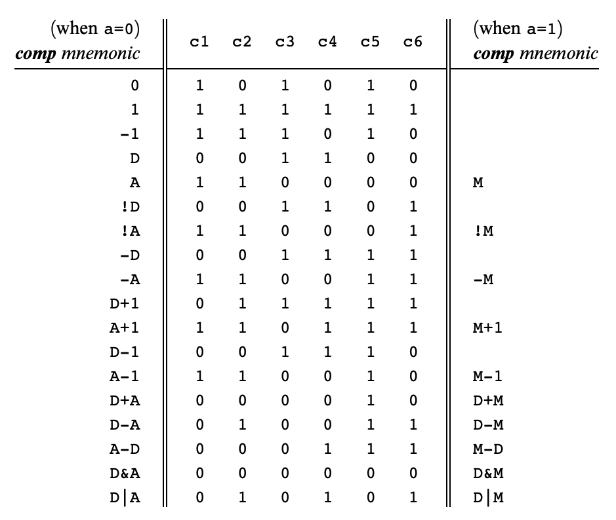
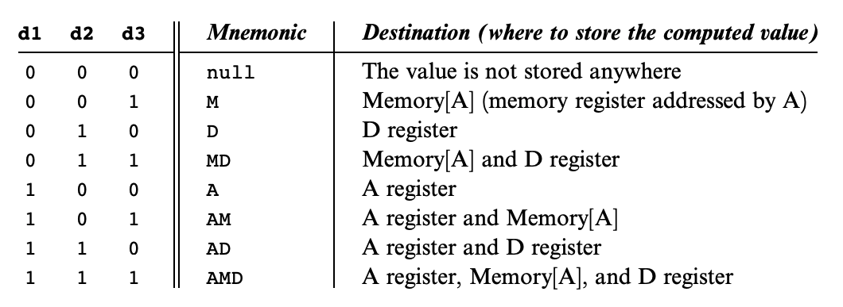
The Assembler’s Job
Look up each value in the corresponding table
D=D+1
1 1 1 0 1 1 1 1 1 0 1 0 0 0 0
Assemble
D+1
D
null

Slide 13
Difficulties for the Assembler
Line #
Address
1
2
3
4
5
6
7
8
9
@12
D=A
@i
M=D // init
(LOOP)
@R3
MD = M-1
@LOOP
D;JGT
0
1
2
3
4
5
6
7
0000000000001100
1110110000010000
0000000000010000
1110001100001000
0000000000000011
1111110010011000
0000000000000100
1110001100000001
Assemble

Slide 14
Difficulties for the Assembler
Three broad concerns:
Parsing
Recognizing type of each instruction and label, extracting relevant fields, skipping whitespace & comments
Symbols
Mapping from labels to instruction addresses, mapping from code symbols to RAM addresses, creating new symbols, corresponding line numbers to instruction addresses
Encoding
Converting relevant fields to binary values, converting symbol values to binary values

Slide 15
Bells and Whistles… Why Bother?
Tradeoff: Adding convenience for programmer makes it harder to build the Assembler
  E.g., removing symbols from Hack would make Assembler much simpler, still possible to write all the same programs
  But language would be far more annoying to use

Slide 16
Bells and Whistles… Why Bother?
Tradeoff: Adding convenience for programmer makes it harder to build the Assembler
  E.g., removing symbols from Hack would make Assembler much simpler, still possible to write all the same programs
  But language would be far more annoying to use
Don’t underestimate the importance of convenience
  Put another way: Adding these extra features makes programmers more productive

Slide 17
Parsing
Source code is just a giant string: we need to go character-by-character to understand that string
Parser presents iterator-like interface:
  To “advance” one instruction:
    Move cursor forward, skipping whitespace and comments, until next non-empty line (ending on a newline)
  To “read” current instruction:
    Throw away whitespace & comments
    Determine what type of instruction
    Pull relevant fields out

Slide 18
Symbols: Labels
Keep symbol table, mapping symbols (strings) to their values (integers)
  Initialize with built-in symbols
SYMBOL | VALUE
R0 | 0
R1 | 1
... | ...
R15 | 15
SCREEN | 16384
KBD | 24576

Slide 19
Symbols: Labels
Keep symbol table, mapping symbols (strings) to their values (integers)
  Initialize with built-in symbols
Run through instructions, using this
pseudocode:
SYMBOL | VALUE
R0 | 0
R1 | 1
... | ...
R15 | 15
SCREEN | 16384
KBD | 24576
If current line is (LABEL):
Add LABEL → next line number to symbol table
If current line is @LABEL:
Lookup LABEL in symbol table, insert value into A instruction

Slide 20
Symbols: Labels
Problem: what if a label’s use comes before its definition?
Line #
1
2
3
4
5
@LOOP
0;JMP
D=M
(LOOP)
@var

Slide 21
Symbols: Labels
Problem: what if a label’s use comes before its definition?
Solution: Two passes
  Pass 1: Populate symbol table by moving through file and ignoring anything that isn’t a (LABEL) line
  Pass 2: Go through file again, ignoring
  (LABEL) lines, encoding C-instructions, and
  encoding A-instructions according to
  symbol table lookup
Line #
1
2
3
4
5
@LOOP
0;JMP
D=M
(LOOP)
@var

Slide 22
Lecture Outline
Stress and Student Wellness
  Investing Time for Self-care and Well-being
Inside the Assembler
  Assembler Motivations and Challenges
  Parsing, Symbols, Encoding
Compilers and The Software Stack
  Steps for Compiling Software
Hack CPU Logic Example: writeM
  Project 6 CPU Logic Exercise

Slide 23
Roadmap
SOFTWARE
HARDWARE
High-Level Language
Intermediate Language(s)
Assembly Language
Operating System
Machine Code
Computer
Memory
CPU
ALU
PC
Basic Logic Gates
NAND

Slide 24
Roadmap
SOFTWARE
HARDWARE
High-Level Language
Intermediate Language(s)
Assembly Language
Operating System
Machine Code
Computer
Memory
CPU
ALU
PC
Basic Logic Gates
NAND

Slide 25
Roadmap
SOFTWARE
HARDWARE
High-Level Language
Intermediate Language(s)
Assembly Language
Operating System
Assembler
Machine Code
Computer
Memory
CPU
ALU
PC
Basic Logic Gates
NAND

Slide 26
Roadmap
SOFTWARE
HARDWARE
High-Level Language
Focus for the rest of the course
Intermediate Language(s)
Assembly Language
Operating System
Assembler
Machine Code
Computer
Memory
CPU
ALU
PC
Basic Logic Gates
NAND

Slide 27
Software
Overview
SOFTWARE
Java
Python
C/C++
Jack
High-Level Language
Compiler
Java Byte Code
Jack VM Code
Intermediate Language(s)
Compiler
(VM Translator)
x86, x86-64
ARM
RISC-V
HACK
Windows
macOS
Unix/Linux
Android
Hack OS
Assembly Language
Operating System
Assembler
Machine Code

Slide 28
Software
Overview
SOFTWARE
Java
Python
C/C++
Jack
High-Level Language
Compiler
Java Byte Code
Jack VM Code
Intermediate Language(s)
Compiler
(Project 7)
Compiler
(VM Translator)
x86, x86-64
ARM
RISC-V
HACK
Windows
Mac
Unix/Linux
Android
Hack OS
Assembly Language
Operating System
Assembler
Machine Code

Slide 29
The Compiler: Goal
public int fact(int n) {
if (n == 0) {
return 1;
} else {
return n * fact(n - 1);
}
}
High-Level Language
(fact)
@R0
M=M+1
@R1
D=A
@ifbranch
D;JEQ
Assembly Language
Compiler

Slide 30
The Compiler: Goal
public int fact(int n) {
if (n == 0) {
return 1;
} else {
return n * fact(n - 1);
}
}
High-Level Language
(fact)
@R0
M=M+1
@R1
D=A
@ifbranch
D;JEQ
Assembly Language
Theory Definition: a string, from the set of strings making up a language
Compiler

Slide 31
The Compiler: Goal
public int fact(int n) {
if (n == 0) {
return 1;
} else {
return n * fact(n - 1);
}
}
High-Level Language
(fact)
@R0
M=M+1
@R1
D=A
@ifbranch
D;JEQ
Assembly Language
Theory Definition: a string, from the set of strings making up a language
Practical Definition: a file containing a bunch of characters
Compiler

Slide 32
The Compiler: Implementation
public int fact(int n) {
if (n == 0) {
return 1;
} else {
return n * fact(n - 1);
}
}
High-Level Language
(fact)
@R0
M=M+1
@R1
D=A
@ifbranch
D;JEQ
Assembly Language
Scanner
Parser
Type Checker
Optimizer
Code Generator
Break string into discrete tokens:
etc.
Arrange tokens into syntax tree:
Verify the syntax tree is semantically correct
Rearrange the code to be more efficient
Convert the syntax tree to the target language
IF
(
ID(n)
+
==
NUM(0)
x
10

Slide 33
Lecture Outline
Stress and Student Wellness
  Investing Time for Self-care and Well-being
Inside the Assembler
  Assembler Motivations and Challenges
  Parsing, Symbols, Encoding
Compilers and The Software Stack
  Steps for Compiling Software
Hack CPU Logic Example: writeM
  Project 6 CPU Logic Exercise

Slide 34
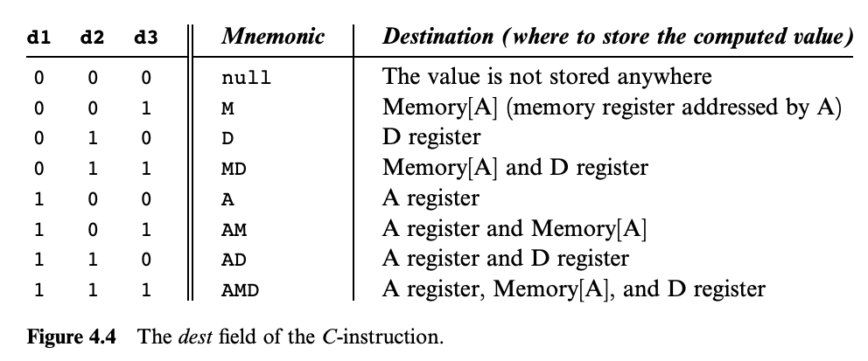
Hack CPU Logic Example: writeM
Example: Determine when writeM should be set to 1
Step 1: What do we pay attention to?
  writeM is related to whether we write to memory or not
  We need to look up the destination bits specification from Chapter 4

Slide 35
Hack CPU Logic Example: writeM
Example: Determine when writeM should be set to 1
Step 2: Determine logic for specification
  Read the “Destination Specification” section of Chapter 4
  Instruction bits:
  1 1 1 a c1 c2 c3 c4 c5 c6 d1 d2 d3 j1 j2 j3

Slide 36
Hack CPU Logic Example: writeM
Example: Determine when writeM should be set to 1
Step 2: Determine logic for specification
  Read the “Destination Specification” section of Chapter 4
  Instruction bits:
  1 1 1 a c1 c2 c3 c4 c5 c6 d1 d2 d3 j1 j2 j3

Slide 37
Hack CPU Logic Example: writeM
Example: Determine when writeM should be set to 1
Step 2: Determine logic for specification
  Read the “Destination Specification” section of Chapter 4
  Instruction bits:
  1 1 1 a c1 c2 c3 c4 c5 c6 d1 d2 d3 j1 j2 j3
  d3 determines if the output should be written to memory
  Which bit of our instruction is that?
  So writeM = instruction[3]?

Slide 38
Hack CPU Logic Example: writeM
Example: Determine when writeM should be set to 1
What’s wrong with writeM = instruction[3]?
  What happens if we have an A-instruction?
  We only write to destinations in the case of a C-instruction
  So, writeM = C-instruction & instruction[3]
  Certain actions only occur on certain instruction types
  You may have to include a check for instruction type in your logic

Slide 39
Hack CPU Implementation: Logic Sub Chips
We provide three sub chips and tests that implement the control logic for the A Register, D Register, and PC
  LoadAReg contains logic for loading the A Register
  LoadDReg contains logic for loading the D Register
  JumpLogic contains logic for determining if the PC should load, jump, or increment
Implement and test these first, then use them in your CPU implementation
  Intended to help you narrow the scope of bugs

Slide 40
Lecture 13 Reminders
Midterm will be graded by this Thursday (11/17)
Please listen to episode one of the Feminist Survival Project podcast
  Be prepared to share one thing you learned this Thursday
Project 6: Mock Exam Problem & Building a Computer due this Thursday (11/17) at 11:59pm
Preston has office hours after class in CSE2 153
  Feel free to post your questions on the Ed board as well

